Slide 1



SECURE SQUAD
IMAGE ENCRYPTION & DECRYPTION
PAGE 1

Slide 2

SECURE SQUAD
In the digital era, sharing images online has become common, but it also increases the risk of unauthorized access, data breaches, and cyber threats. Sensitive images shared over networks can be intercepted, misused, or tampered with if not properly secured.
There is a need for a reliable system that can securely encrypt and decrypt images during storage and transmission.
This project aims to develop a web-based solution using the AES algorithm to ensure that images are securely encrypted before transmission and accurately decrypted upon receipt. The system will be built using Flask for the backend and React for the frontend, providing a simple and user-friendly platform for image protection.
PROBLEM STATEMENT
PAGE 2

Slide 3
SECURE SQUAD
ALGORITHM USED
The Advanced Encryption Standard (AES) is one of the most widely used encryption algorithms for securing digital data. It is a symmetric block cipher, meaning the same key is used for both encryption and decryption, ensuring faster and more efficient data protection.
Why Use AES for Image Encryption?
High Security: Strong protection against brute-force and cryptographic attacks
Speed: Fast encryption and decryption processes, suitable for large data
Efficiency: Uses fewer resources, making it ideal for web-based applications
Global Standard: Widely adopted for securing sensitive information worldwide
Key Benefits
Confidentiality – Protects images from unauthorized access.
Integrity – Ensures the image remains unchanged during transmission.
Security – Uses AES, a highly secure encryption standard.
User-Friendly – Simple web interface for encryption and decryption.
PAGE 3

Slide 4
SECURE SQUAD
Key Expansion: Initial key is expanded into multiple smaller keys.
2.Initial Round: XOR operation with the key.
3.Main Rounds (Depends on key size: 10, 12, or 14 rounds)
>SubBytes: Byte substitution using an S-box.
>ShiftRows: Row shifting for diffusion.
>MixColumns: Column mixing for confusion.
>AddRoundKey: XOR with round key.
4.Final Round: Same as main rounds but without MixColumns.
WORKING OF ALGORITHM
PAGE 4

Slide 5
SECURE SQUAD
OBJECTIVE
The main objective of this project is to develop a secure and user-friendly web application for image encryption and decryption using the AES algorithm.
Secure Images: Protect sensitive images from unauthorized access during storage and transmission.
Implement AES Encryption: Use the Advanced Encryption Standard (AES) for efficient and strong encryption and decryption.
Develop a Web-Based Platform: Build a simple and interactive interface using Flask (backend) and React (frontend).
Ensure Fast Processing: Provide quick encryption and decryption without compromising security.
Maintain Data Integrity: Ensure that the images remain unchanged during encryption, transmission, and decryption.
Raleway
Raleway
Raleway
PAGE 5

Slide 6
TOOLS USED
BACKEND
Python
Flask
flask-cors
PyCryptodome
FRONTEND
React JS
Axios
CSS
SECURITY ALGORITHM
-AES (Advanced Encryption Standard)
DEVELOPMENT TOOLS
Visual Studio Code (VS Code)
GitHub
RUNTIME ENVIRONMENT
Node.js
Python Virtual Environment
PAGE 6

Slide 7
BACKEND IMPLEMENTATION
The backend of this project is built using Flask (a Python framework) and handles the main logic for encrypting and decrypting images using the AES algorithm.
1. Setup and Install Libraries
Create a virtual environment
Install necessary libraries (flask, flask-cors, pycryptodome)
2. AES Key Generation
Generates a 16-byte encryption key for securing images.
Uses ECB mode (Electronic Codebook) for encryption.
Adds padding to ensure data fits the block size requirement.
3. Main Functions
Encrypt Image: Converts the image into an unreadable format.
Decrypt Image: Converts the encrypted data back into the original image.
4. API Endpoints
GET / – Checks if the server is running.
POST /encrypt – Encrypts the uploaded image.POST /decrypt – Decrypts the encrypted data and returns the original image.
5. Run the Server
The backend server runs on: http://localhost:5000
PAGE 7

Slide 8
SECURE SQUAD
FRONTEND IMPLEMENTATION
FRAMEWORK AND TOOLS USED
React: A JavaScript library used to build the user interface.
Axios: Helps in sending and receiving data from the backend.
CSS: Used for basic styling to create a simple and clean design.
MAIN FEATURES:
Upload an image from your device.
Encrypt the image and display the encrypted data.
Decrypt the encrypted data back to the original image.
USER INTERFACE:
Simple and clean design.
Buttons for encryption and decryption.
Display area for encrypted data and decrypted image.
BACKEND CONNECTION:
Communicates with the backend using API calls for encryption and decryption.
Runs on http://localhost:3000 for easy access through a web browser.
PAGE 8

Slide 9
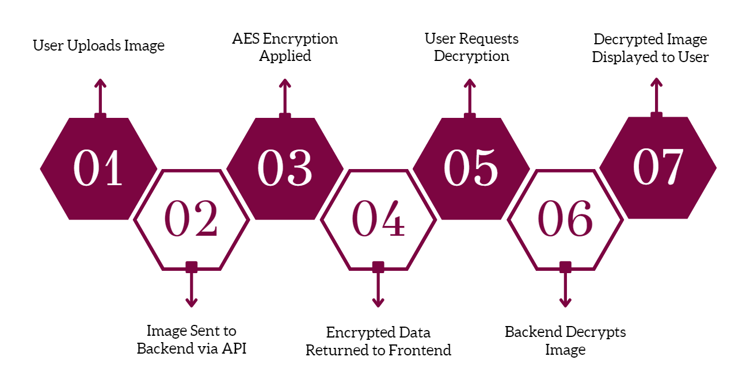
SECURE SQUAD
ARCHITECTURE
PAGE 9

Slide 10
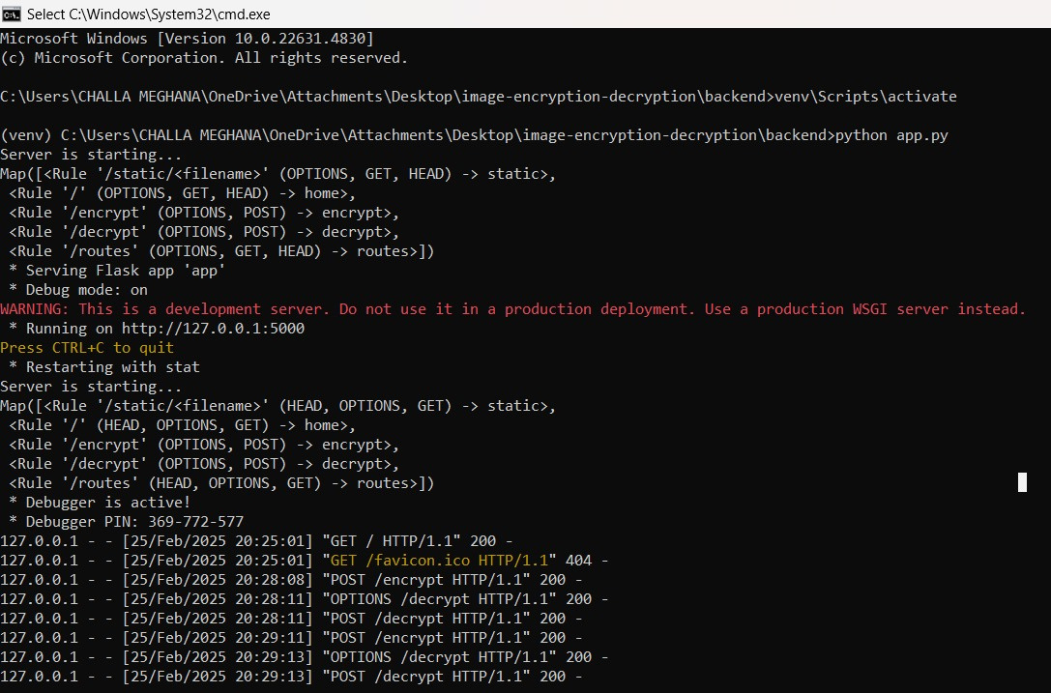
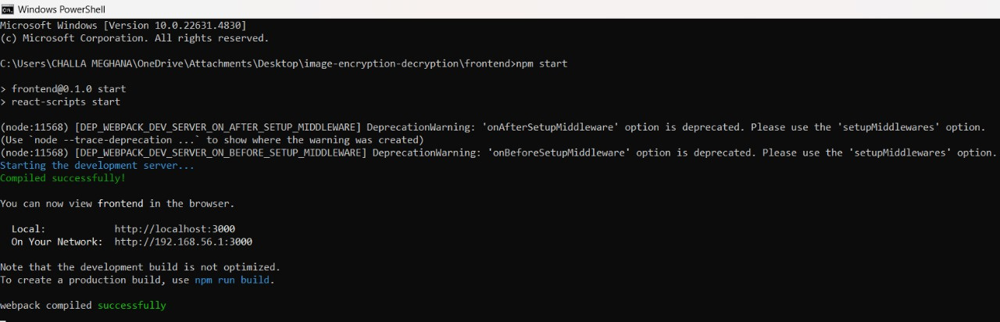
SECURE SQUAD
DEMO SCREEN SHOT
PAGE 10

Slide 11
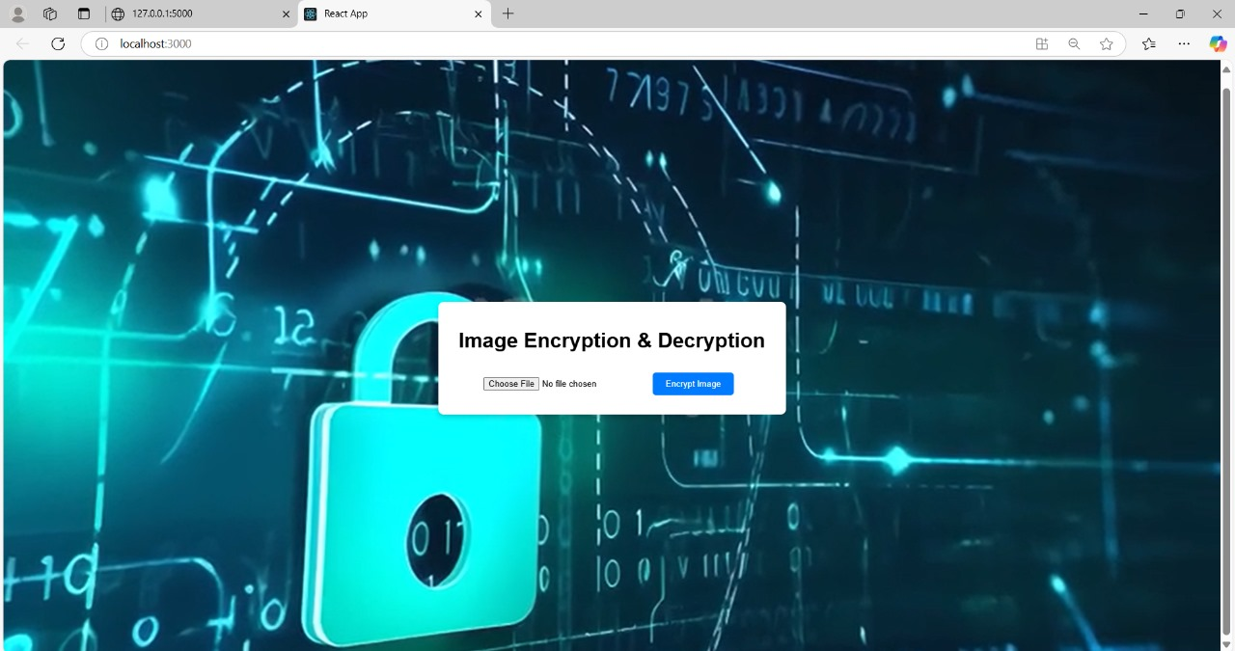
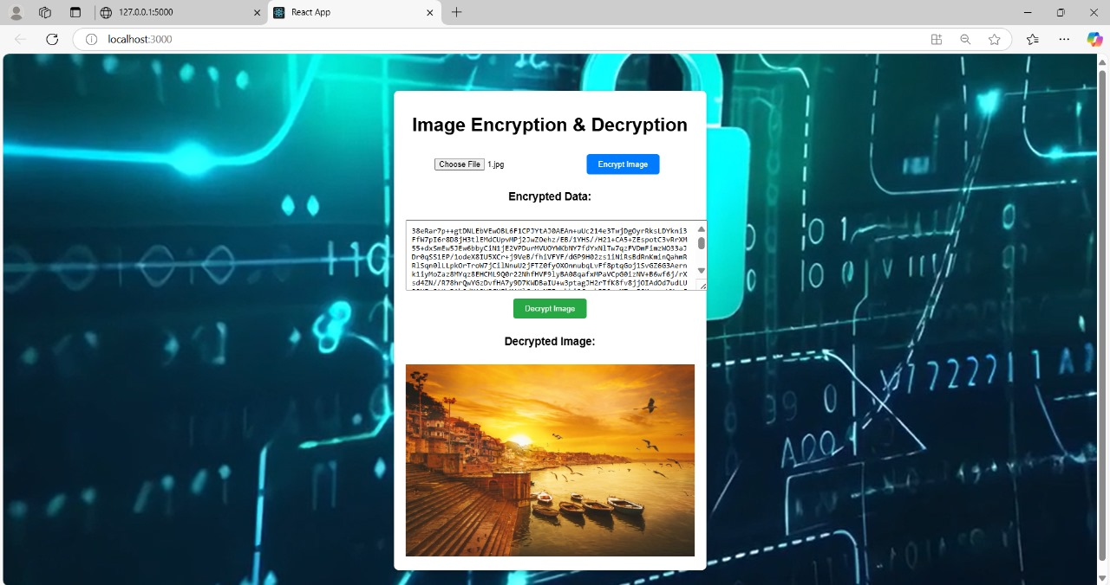
SECURE SQUAD
PAGE 11

Slide 12
SECURE SQUAD
Challenges:-
Secure Key Management: Keeping the AES encryption key safe.
Handling Large Images: Encrypting and decrypting big files without slowing down.
Cross-Origin Requests: Ensuring smooth connection between React frontend and Flask backend.
Error Handling: Managing issues like wrong file formats or failed decryption.
CHALLENGES AND SOLUTIONS
Solutions:-
Key Security: Generate a new random key every time the server starts.
Efficient Processing: Optimize functions to handle large images faster.
Enable CORS: Use flask-cors for smooth frontend-backend communication.
Clear Error Messages: Inform users about issues with helpful messages.
PAGE 12

Slide 13

SECURE SQUAD
CONCLUSION
This project successfully demonstrates a secure and efficient method for image encryption and decryption using the AES algorithm. By integrating a Flask backend with a React frontend, it provides a user-friendly platform for protecting sensitive images during storage and transmission.
The use of AES ensures strong security, maintaining the confidentiality, integrity, and safety of image data. The system effectively handles encryption, decryption, and smooth communication between the backend and frontend while addressing challenges like key management, large file handling, and error detection.
FUTURE WORKS:
Stronger Encryption Modes:
Implement more advanced encryption techniques, such as AES with CBC (Cipher Block Chaining) mode or even quantum-resistant algorithms for enhanced security.
Cloud Storage Integration:
Enable secure cloud storage options for encrypted images, allowing users to upload, store, and access their encrypted files from anywhere.
PAGE 13

Slide 14
SECURE SQUAD
THANK YOU !

